Slide 1
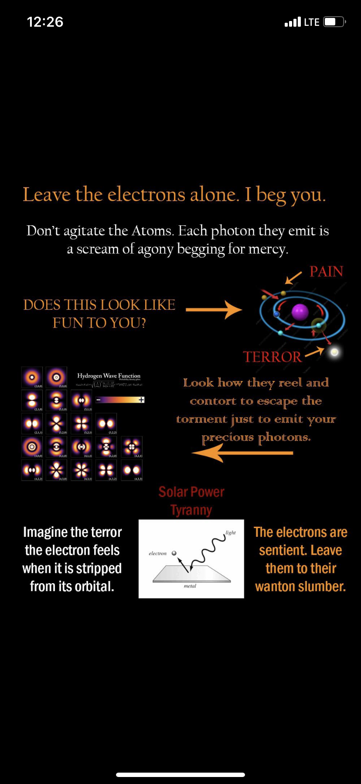
Lab meeting 7.7.22

Slide 2
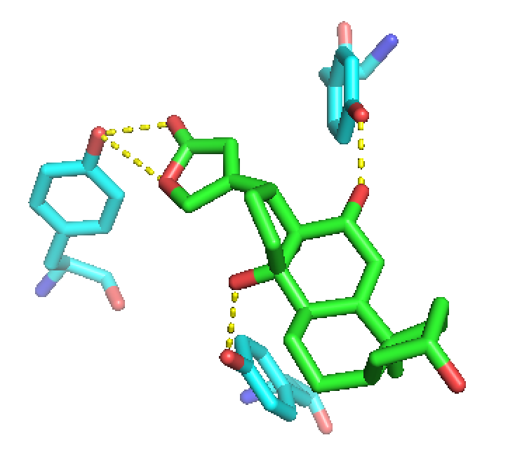
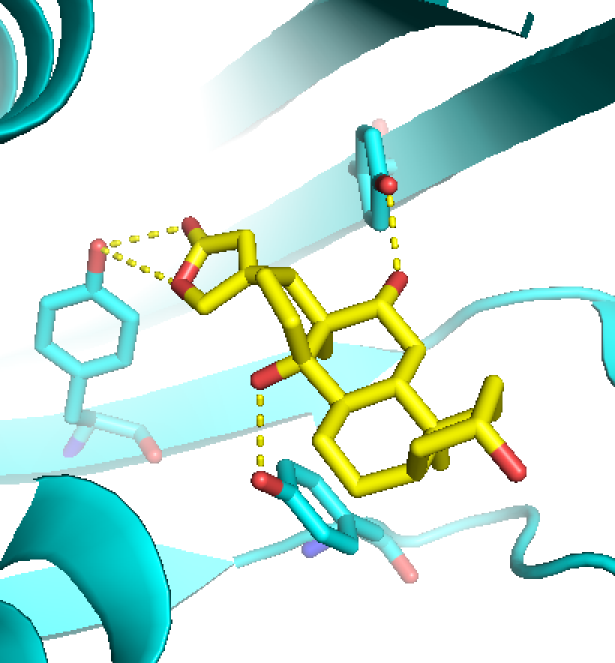
Simultaneously sampling both protein and ligand degrees of freedom is too much, matching allows for defining ligand position/orientation relative to the rest of the protein
Graft motif residues into existing protein scaffold
Define key interacting sidechains = ‘motif’
Match
→→→
Other notable strategies = RIFdock and COMBS (DeGrado lab)
+constrained hallucination now

Slide 3
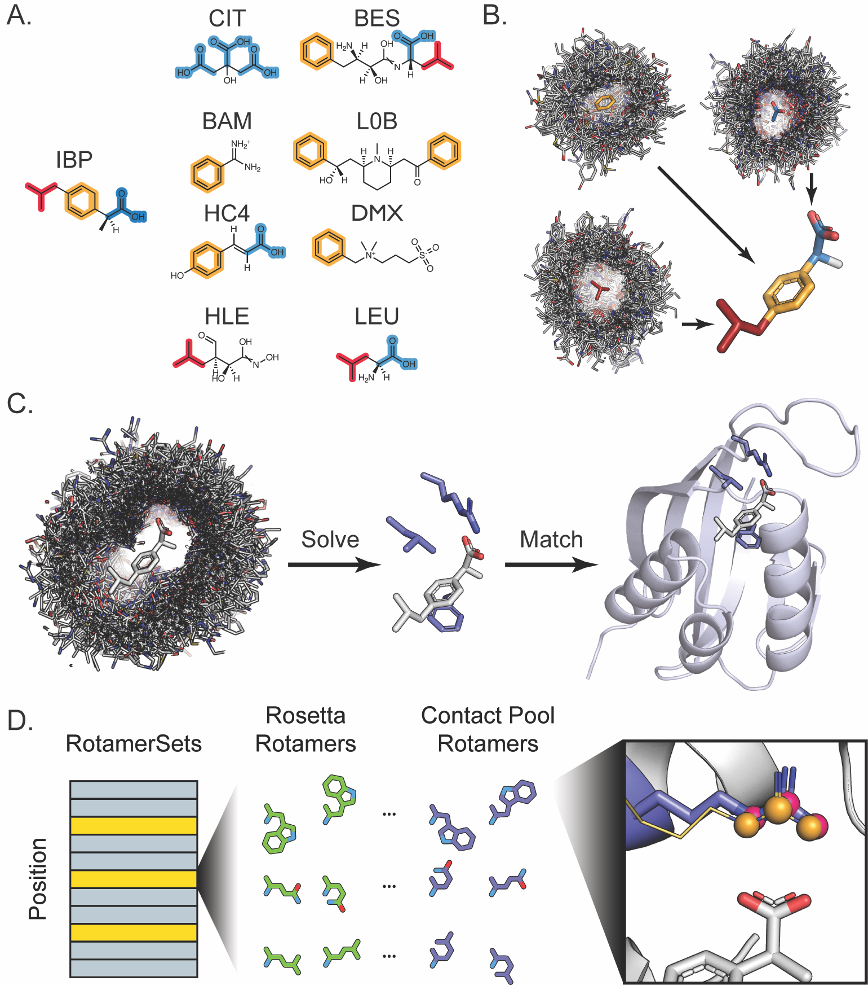
→Binding Sites From Fragments (BSFF) Generates Many Low Energy Motifs
Protocol Overview
A. Define Fragments of target molecule.
B. Scrape PDB for protein-fragment contacts and spatially transform relative to target molecule.
C. Monte Carlo assembly of binding motifs from contact pool
J Lucas & T Kortemme (2020)

Slide 4
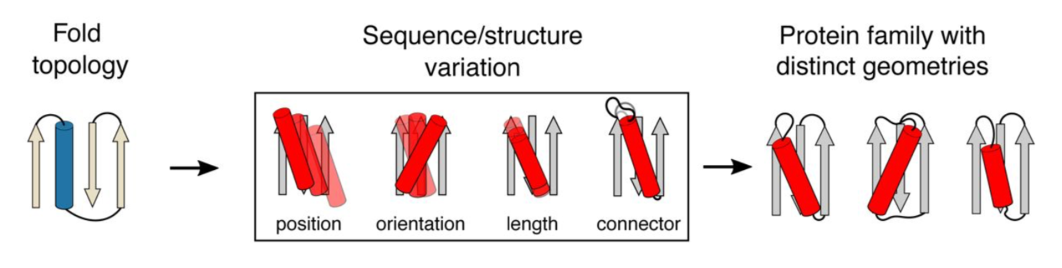
→Loop-helix-loop Unit Combinatorial Sampling (LUCS) Generates Many Geometrically Diverse Scaffolds
Single scaffold geometry → Thousands of LUCS generated designs with diverse geometries
Xingjie Pan et al. (2020)

Slide 5
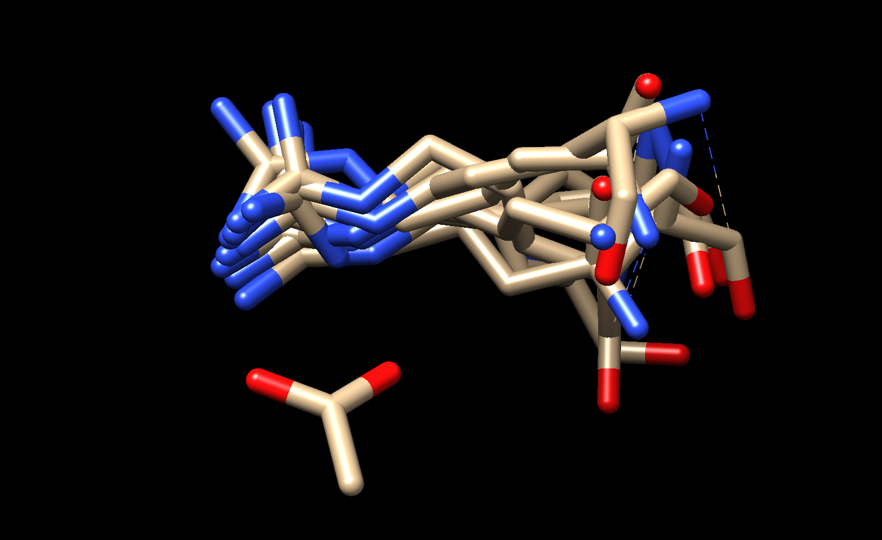
Spatial clustering of protein-ligand contacts reveals strongly preferred interaction modes for each chemical fragment, which are not reflected by their Rosetta energy scores
Example of a highly populated cluster for an acetate fragment
Cluster Population Distribution: Acetate Fragment
→Build motifs from highly populated contact modes

Slide 6
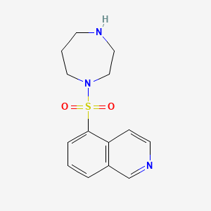
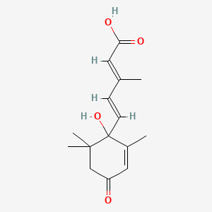
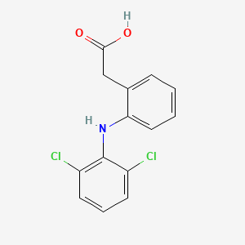
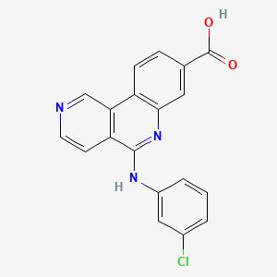
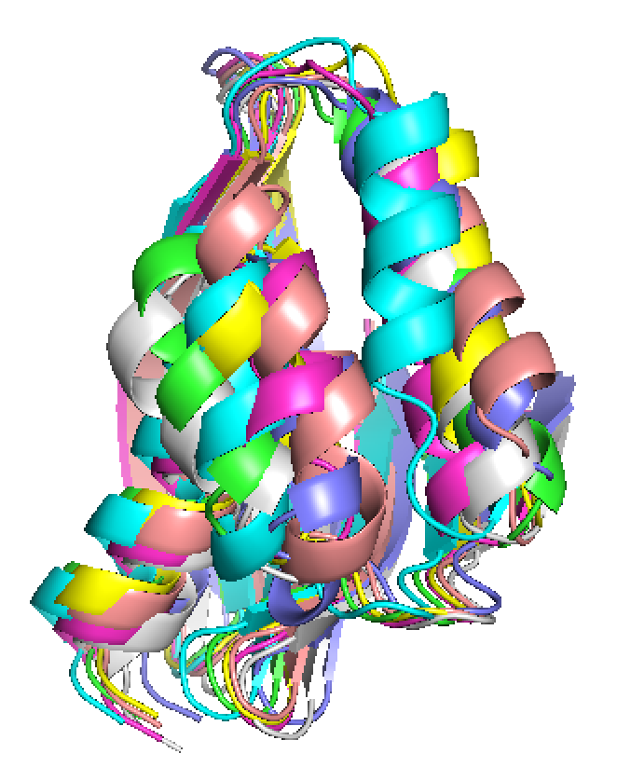
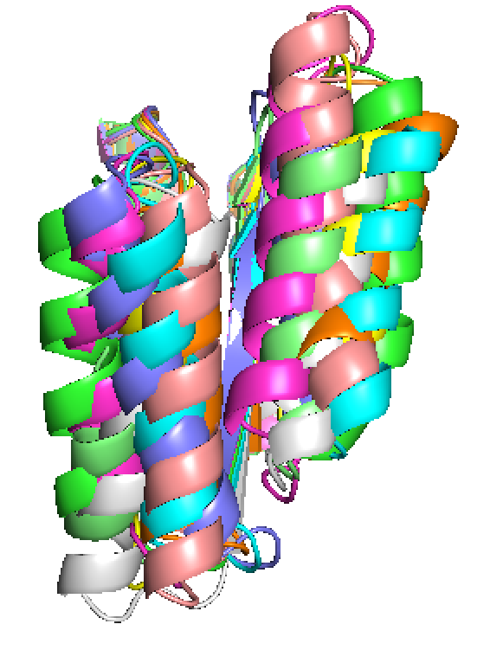
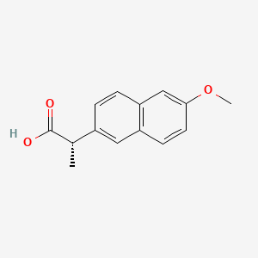
Combining BSFF+LUCS
Matching motifs for one molecule with many scaffolds
Motif Library = 3,740
3-residue motifs across 5 small molecules (~800 ea), filtered by score and hydrogen bond satisfaction
Fasudil – M77
Abscisic Acid – A8S
Diclofenac - DIF
Silmitasertib – 3NG
Scaffold Library = 1,100 LUCS designs from two input topologies, filtered according to stability metrics (packing statistics, sequence-structure compatibility, etc.)
Naproxen - NPS

Slide 7
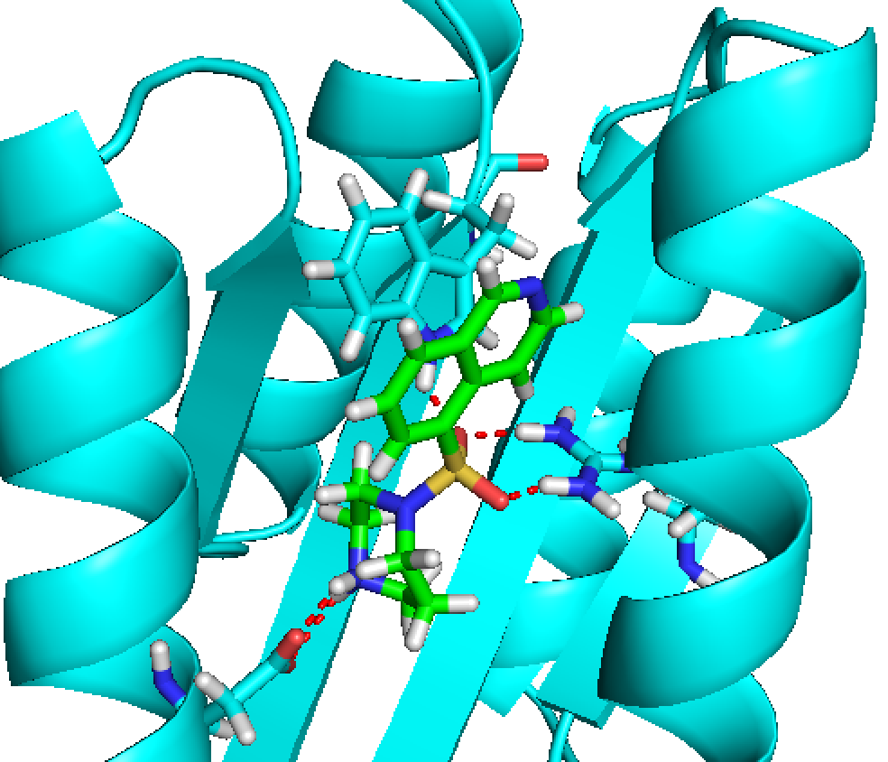
Matching motifs for one molecule with many scaffolds
Get at least hundreds of matches for each target
9,234 high-fidelity matches across all targets (relevant distances allowed to deviate 0.3 angstroms, angles 5-15 degrees)
Fasudil – 952 matches
Naproxen – 665 matches
Diclofenac – 2,176 matches
Abscisic Acid – 5,076 matches
Silmitasertib – 365 matches
Close up of a matched binding site for Fasudil showing hydrogen bond network between ligand and motif residues

Slide 8
Naproxen Binder Design Quality
Too few protein-ligand hbonds

Slide 9
→New clustering/matching strategy for polar contacts
Cluster polar contacts by geometries (relevant angles and distances) rather than RMSD for each polar fragment (also ensures all clustered contacts are isoenergetic and unique)
Rank clusters by observed frequency
Generate motifs by simply enumerating most favorable combinations (ie for 3 polar fragments, motif1 = 1-1-1, motif2=1-1-2, motif3=1-2-1, etc.)
Set match constraints to edges of bin from which each interaction is derived (ie if cluster is defined by d=2.0-2.1 Å, angle1=170-180, .cst file will constrain interaction to within those ranges of values)

Slide 10
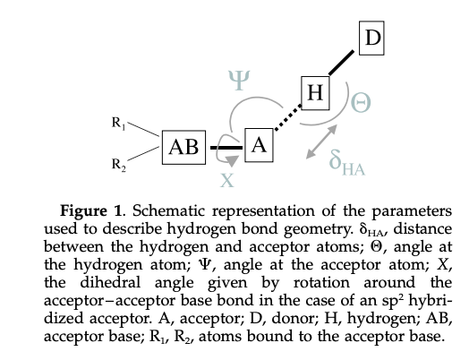
Matching .cst file contains two additional torsions, set tolerance on these to 360 degrees (any value acceptable)

Slide 11
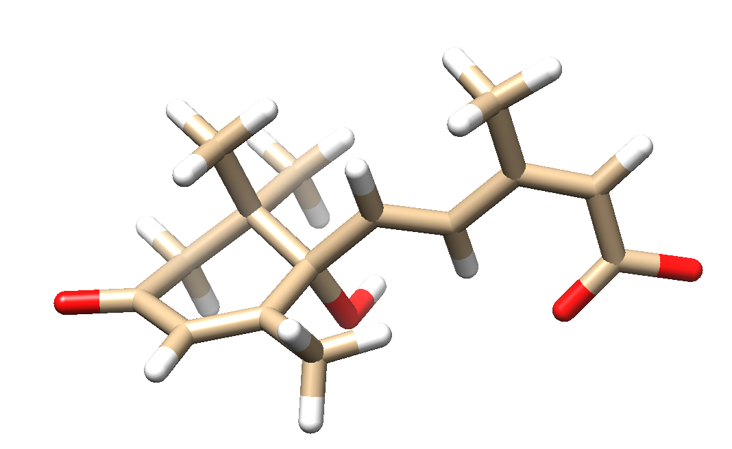
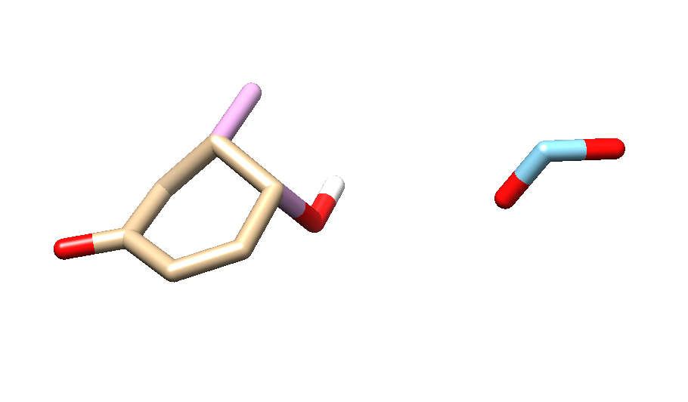
Testing Hbond Motifs with Abscisic Acid

Slide 12
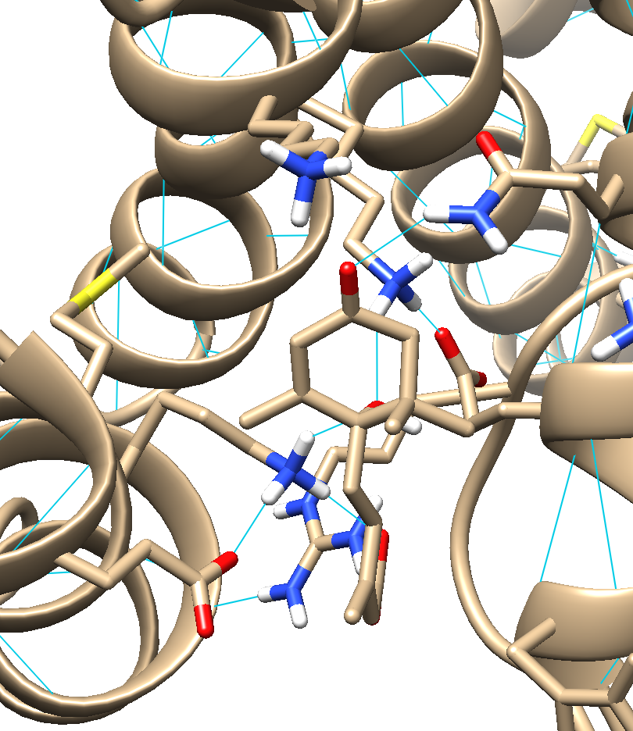
Testing Hbond Motifs with Abscisic Acid: Filtered Designs
78k matches!
51 designs that meet stringent quality criteria:
Oversat<=1
Hbtolig>=3
Boltz<=-0.3
shape complementarity>=0.6
Dsasa>=0.08
Now binding sites look TOO polar

Slide 13
Hybrid Approach
Continue testing with A8S
Enumerate 3 residue polar motifs as previously described, but
To each, add 1 of the top 10 most populated nonpolar contacts
→864 4-residue hybrid motifs
matched with 1,102 filtered LUCS scaffolds
→23,815 matches
10 designs each match, filter to those with 0 unsatisfied hbonds, no oversaturated hbond acceptors, shape complementarity>0.8, ligand hydrophobic SASA < 50 Å²
→22 round 1 designs passing filters
100 round 2 designs on each of these 22, quality metrics evaluated, 18 designs passing 9 very strict quality criteria describing both hydrogen bond satisfaction and binding site packing

Slide 14
Hybrid Approach – comparison of design quality with 4 monomeric a8s binder crystal structures
Ligand hydrophobic SASA
Designs
Natural

Slide 15
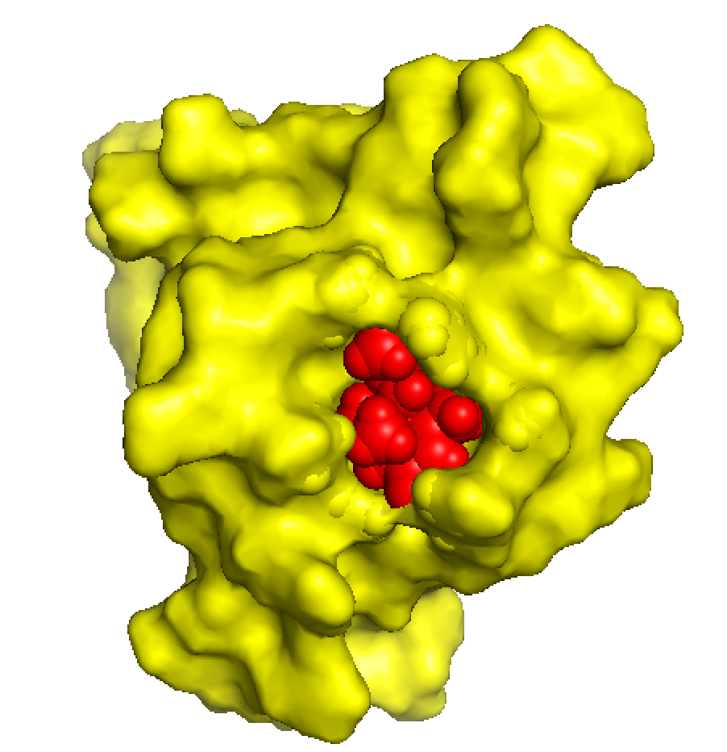
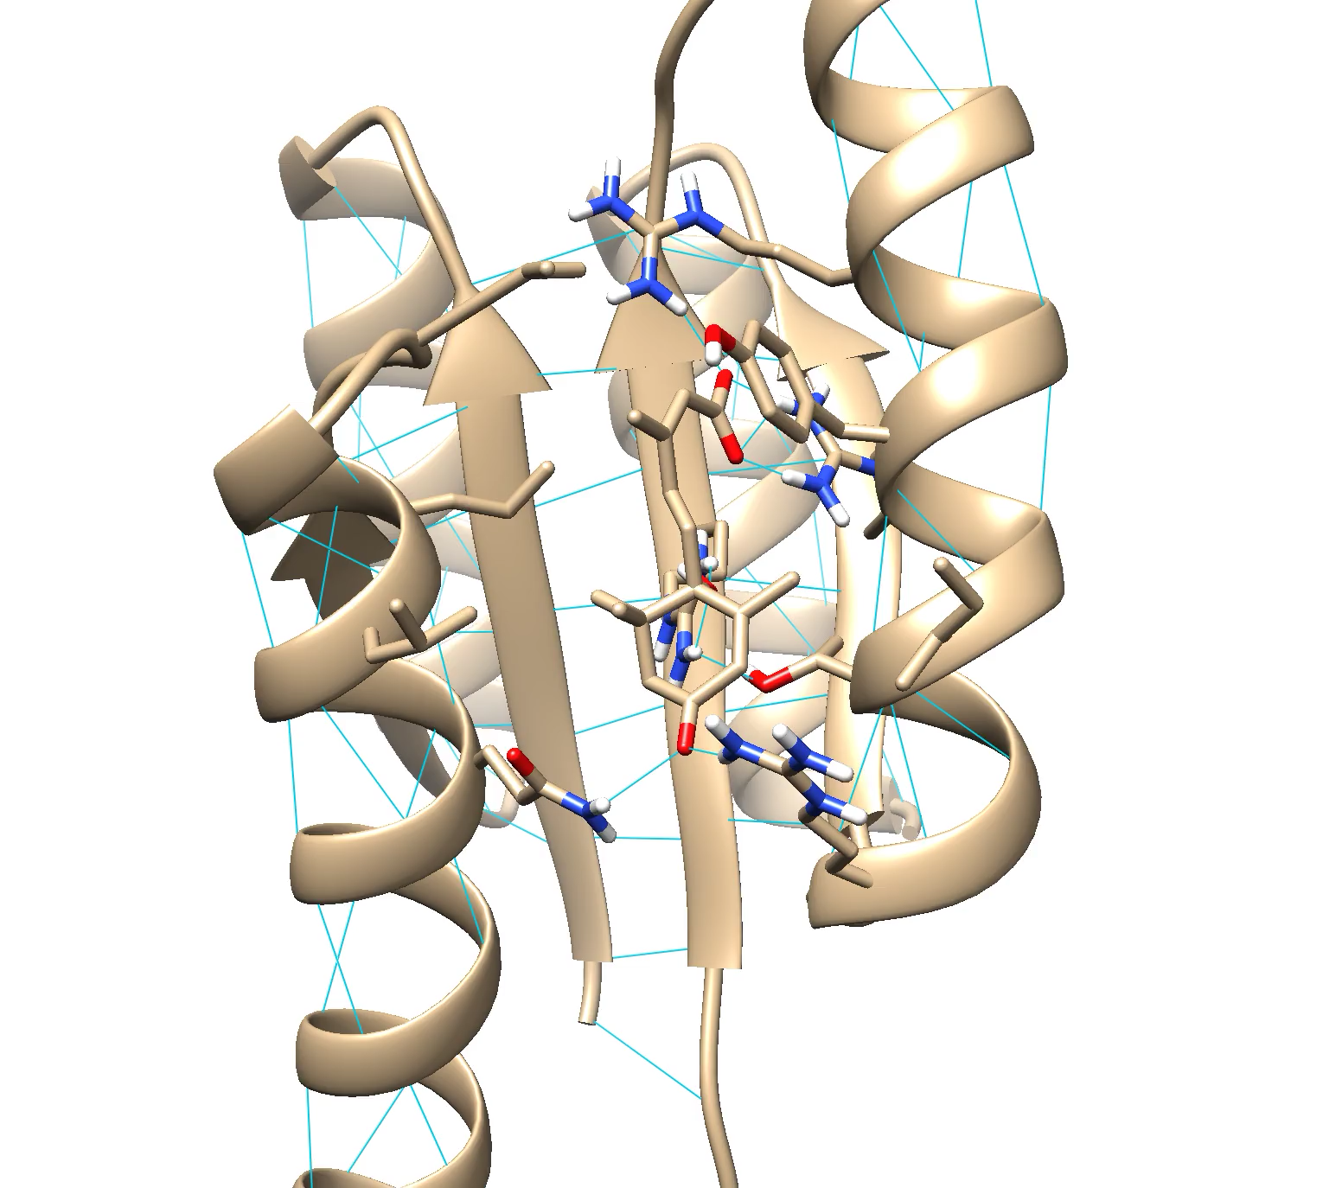
Hybrid Approach – Design Example

Slide 16
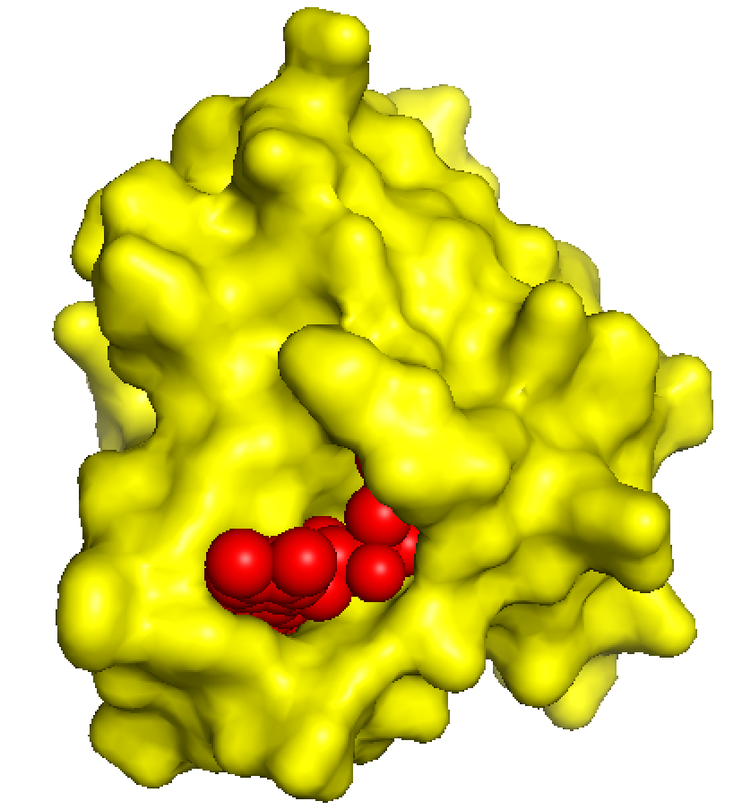
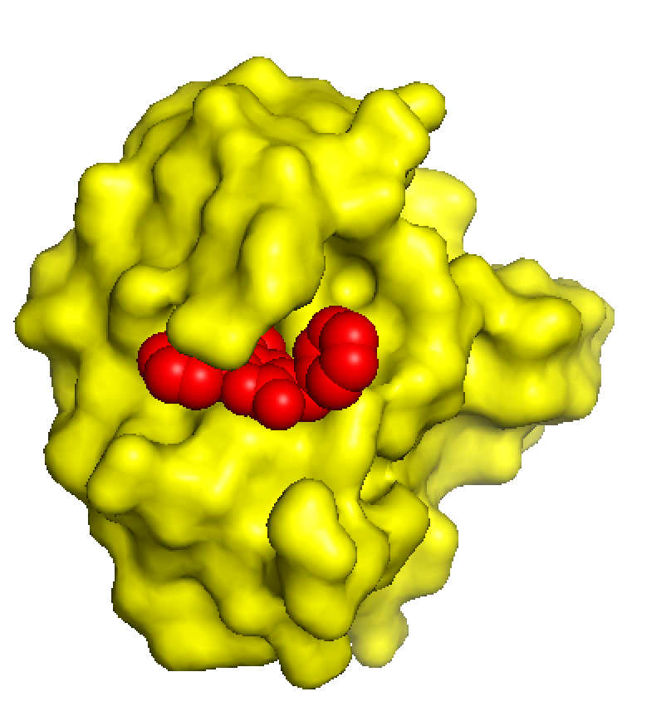
Naturally Occurring Rossman Fold Binders look Sketchy
2XOD – Rossman fold binding FMN
5WBN – Rossman fold binding 9ZV

Slide 17
Updates to Protocol
BSFF search for fragment containing molecules in PDB is now exhaustive/consistent

Slide 18
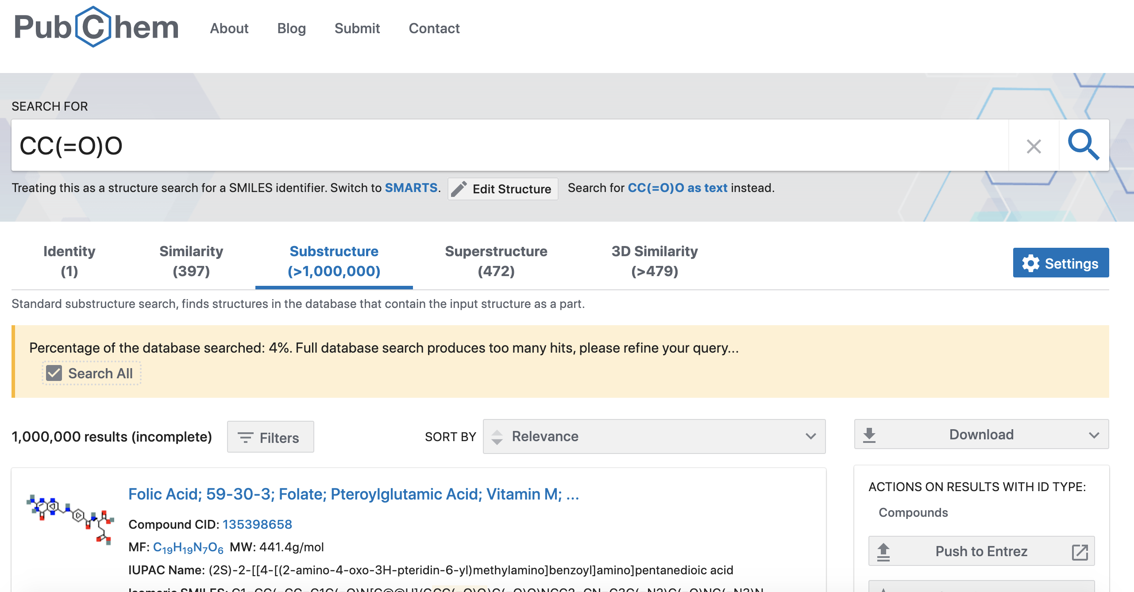
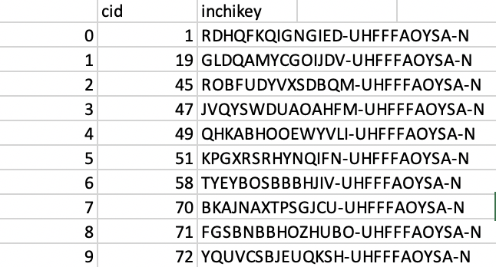
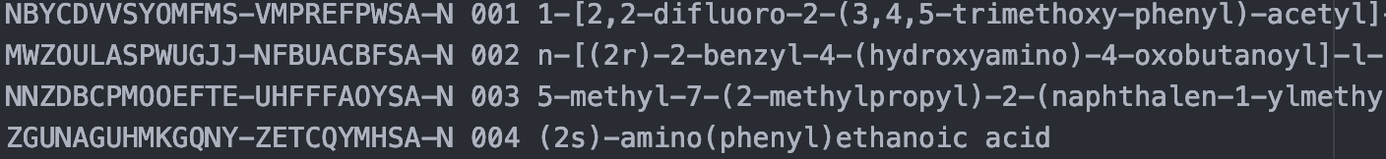
→Binding Sites From Fragments (BSFF)
Identifying Small Molecules which Contain Target Fragment as a Substructure
Use Pubchem substructure search to identify small molecules which contain fragment as substructure, download Inchis of fragment-containing compounds (Inchi=unique string identifier for every compound)
Check list of Inchis against those of small molecules in PDB (PDB publishes a spreadsheet with Inchi/PDB ID of every ligand with an entry, updated monthly), get the relevant PDB IDs
Download crystal structures for all of those PDB IDs

Slide 19
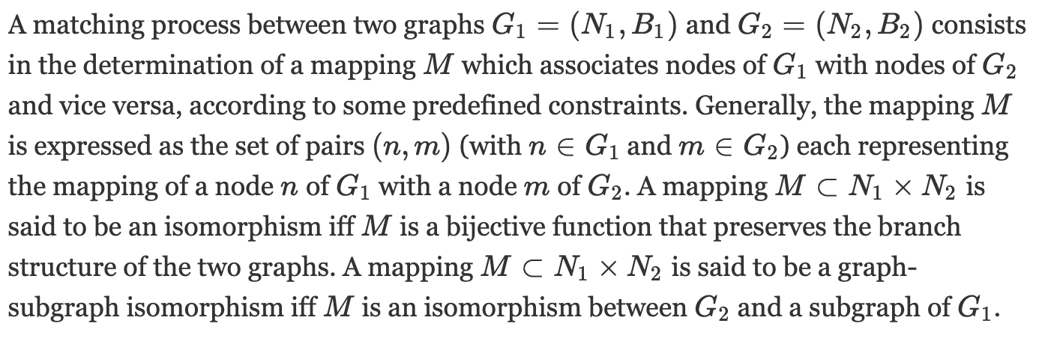

You’ve gotta do something called subgraph isomorphism
Treat the molecules as a graph with atoms as vertices and bonds as edges, numerous algorithms exist to determine whether one is isomorphic with a subgraph of the other
Rdkit has a built-in function to do this, uses ‘vf2’ algorithm, don’t know the details of how it works and don’t care!! It’s fast and seems to work great!
When I compare the number of PDB ligands returned for acetate from this new method with that of Pubchem method, I get 9,497 ligands, compared with 5,269

Slide 20
Updates to Protocol
BSFF search for fragment containing molecules in PDB is now exhaustive/consistent
Only hydrogen bonds with distance <= 2.4 angstroms allowed in motifs (discarding highly populated clusters around 3.4 angstroms representing water-mediated hbonds)

Slide 21
Updates to Protocol
BSFF search for fragment containing molecules in PDB is now exhaustive/consistent
Only hydrogen bonds with distance <= 2.4 angstroms allowed in motifs (discarding highly populated clusters around 3.4 angstroms representing water-mediated hbonds)
Incorporating AF/ProteinMPNN into design workflow
→scaffold library now = 419 MPNN redesigned LUCS NTF2 structures with AF2 plddt >=80.0
→match design protocol = FD→MPNN (no design on binding site residues)→AF2→FastRelax w/ match csts→score

Slide 22
New Scaffold Library
Last round of filtered a8s designs showed high ligand exposed hydrophobic surface area, were all designs on Rossman folds
→Matches on NTF2/naturally occurring scaffolds did indeed have greater ligand burial on average, but were being filtered out early mainly for:
-buried unsatisfied polar atoms at the protein ligand interface (makes sense this is more of a problem with greater ligand burial, good rossman matches lost this way too )
-structural quality metrics (backbone buried unsatisfied polar atoms, packing statistic, cavity volume, etc.)
Additionally, the more liberal hydrogen bond constraints allow for many thousands of matches, I don’t need so large a scaffold library, better to have fewer with more trustworthy quality metrics
→125 LUCS NTF2 structures in current library redesigned with MPNN

Slide 23
125 NTF2 structures in current library redesigned with MPNN
Temp=0.25; 500 seqs per backbone
10 best scoring sequences for each backbone submitted to AF
Distribution of avg plddts for 125 original structures and 1250 selected MPNN designs
along with 125 highest plddt structures for each backbone:
One round of MPNN increases mean plddt from ~63 to ~73
The mean plddt for the best design for each backbone is ~88

Slide 24
125 NTF2 structures in current library redesigned with MPNN: Round 2
FastRelax 125 highest plddt structures for each bb and submit for another round of design with MPNN
Temp=0.15; 1000 seqs per backbone
10 best scoring sequences for each backbone submitted to AF
Distribution of avg plddts for 125 original structures and 1250 selected MPNN designs
along with 125 highest plddt structures for each backbone:
Second round of MPNN increases mean plddt from ~73 to ~79 (~63 for originals)
After round 2, the mean plddt for the best design for each backbone increases from ~88 to ~91

Slide 25
419 Designs Selected for Matching
= up to 5 for each of 125 backbones, plddt>80.0
Comparison of Rosetta Metrics for 125 original and 419 selected ‘best’ Designs:
Fa atr lower
Fa rep higher
Statistical things lower (p_aa_pp, fa_dun)
Fa sol higher, lk ball lower

Slide 26
419 Designs Selected for Matching
= up to 5 for each of 125 backbones, plddt>80.0
Comparison of Rosetta Metrics for 125 original and 419 Designs:
Atomic Contact Count
Buried Nonpolar Surface Area

Slide 27
419 Designs Selected for Matching
= up to 5 for each of 125 backbones, plddt>80.0
Comparison of Rosetta Metrics for 125 original and 419 Designs:
Exposed hydrophobic surface area
Cavity volume

Slide 28
419 Designs Selected for Matching
= up to 5 for each of 125 backbones, plddt>80.0
Comparison of Rosetta Metrics for 125 original and 419 Designs:
Packing statistic

Slide 29
419 Designs Selected for Matching
= up to 5 for each of 125 backbones, plddt>80.0
Comparison of Rosetta Metrics for 125 original and 419 Designs:

Slide 30
419 Designs Selected for Matching
= up to 5 for each of 125 backbones, plddt>80.0
Comparison of Rosetta Metrics for 125 original and 419 Designs:

Slide 31
419 Designs Selected for Matching
= up to 5 for each of 125 backbones, plddt>80.0
Comparison of Rosetta Metrics for 125 original and 419 Designs:

Slide 32
Matching A8S 4-Residue Hybrid Motifs with MPNN NTF2 Scaffold Library
A8S
Enumerate 3 residue polar motifs as previously described
To each, add 1 of the top 25 most populated nonpolar contacts
→404 4-residue hybrid motifs
matched with 419 filtered LUCS scaffolds
→11,975 matches (stopped early)
2,218 matches randomly selected for FastDesign

Slide 33
Rosetta Quality Metrics for 2,218 A8S Designs
-
Ligand Hydrophobic SASA improved relative to last round of designs, though oddly bimodal
Old designs
New designs

Slide 34
Rosetta Quality Metrics for 2,218 A8S Designs
-
Contact Molecular Surface improved, also bimodal
Old designs
New designs

Slide 35
Rosetta Quality Metrics for 2,218 A8S Designs
-
The interface BUNS are comparable to last round of designs, even though greater ligand burial
Old designs
New designs

Slide 36
Selecting A8S Binder Designs for MPNN
A8S
Enumerate 3 residue polar motifs as previously described
To each, add 1 of the top 25 most populated nonpolar contacts
→404 4-residue hybrid motifs
matched with 419 filtered LUCS scaffolds
→11,975 matches (stopped early)
2,218 matches randomly selected for FastDesign
44 Designs selected for MPNN with:
Interface BUNS <= 1
Ligand Hydrophobic SASA <= 10
Contact Molecular Surface >= 160
Temp = 0.1; 500 sequences each design
Design off for all 4 motif residues, as well as any residue with a res-ligand 2-body energy<0.0
Top 10 sequences for each of 44 inputs sent to AF

Slide 37
A8S Binder Design with MPNN
A8S
Cannot easily get ligand back into AF models of MPNN designs
-relax w/ just match csts→ blows up the proteins
-relax w/ match csts + constrain to start cords + minimize → structures look more reasonable, but scores still poor

Slide 38
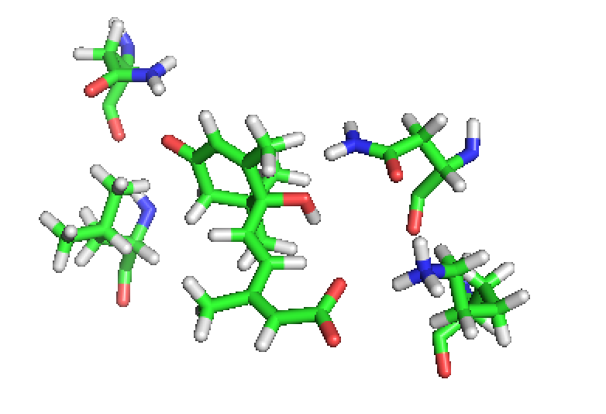
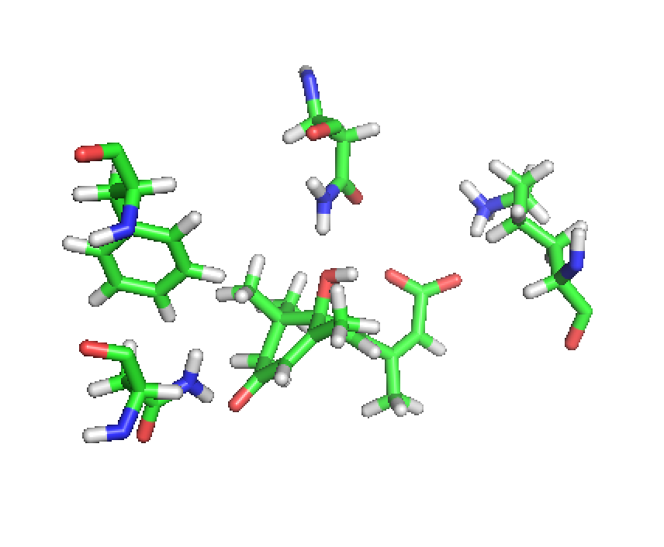
Selected Design Examples – Matched Motifs

Slide 39
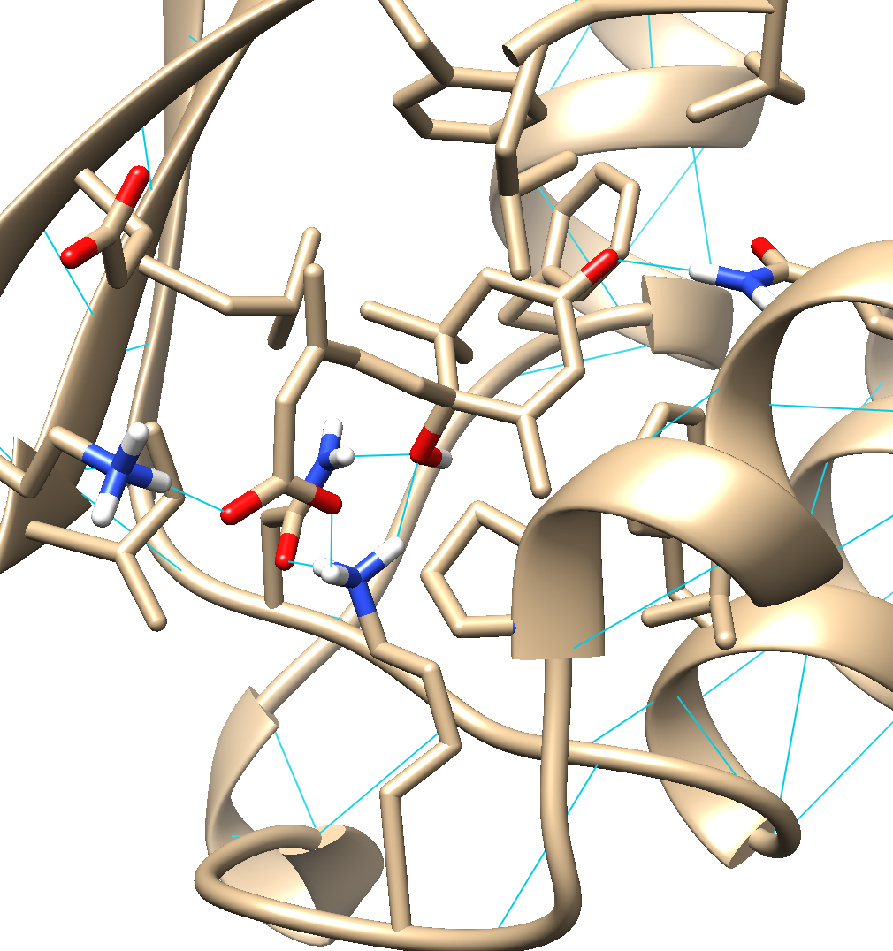
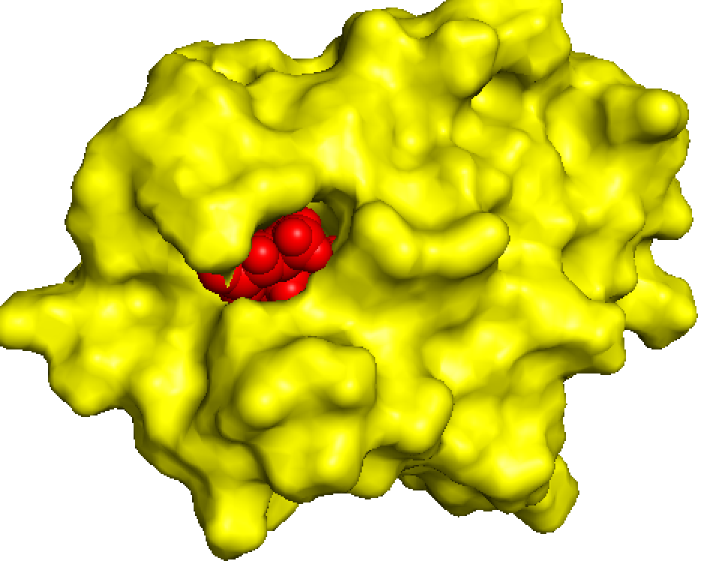
Selected Design Examples –
dense hbond networks, great ligand burial

Slide 40
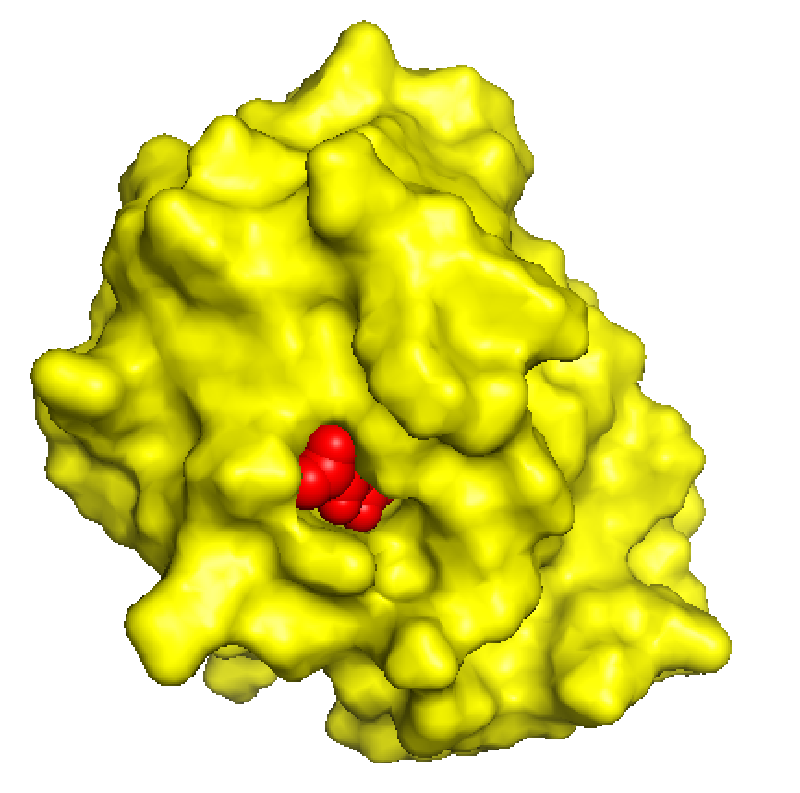
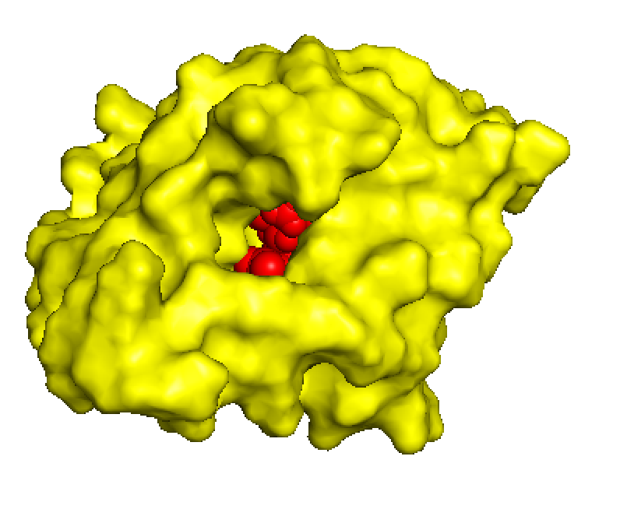
Selected Design Examples
- These really look like binding pockets!

Slide 41
AF Confidence for Filtered Rosetta Designs
3 designs with average plddt >= 85,
Ca RMSD <= 1.0 Å
Shall we take a gander?

Slide 42
Compare with Values for Naturally Occurring Binders

Slide 43
Rosetta Metrics for High AF Confidence Rosetta Designs
19 heavy atoms - -1.096*19 = -20.824

Slide 44
Compare with Values for Naturally Occurring Binders

Slide 45
Compare with Values for Naturally Occurring Binders

Slide 46
Compare with Values for Naturally Occurring Binders

Slide 47
Compare with Values for Naturally Occurring Binders
4 O → 1 / 4 = 0.25

Slide 48
Compare with Values for Naturally Occurring Binders
4 O → 3 / 4 = 0.75

Slide 49
Compare with Values for Naturally Occurring Binders
-
Boltz probabilities too low

Slide 50
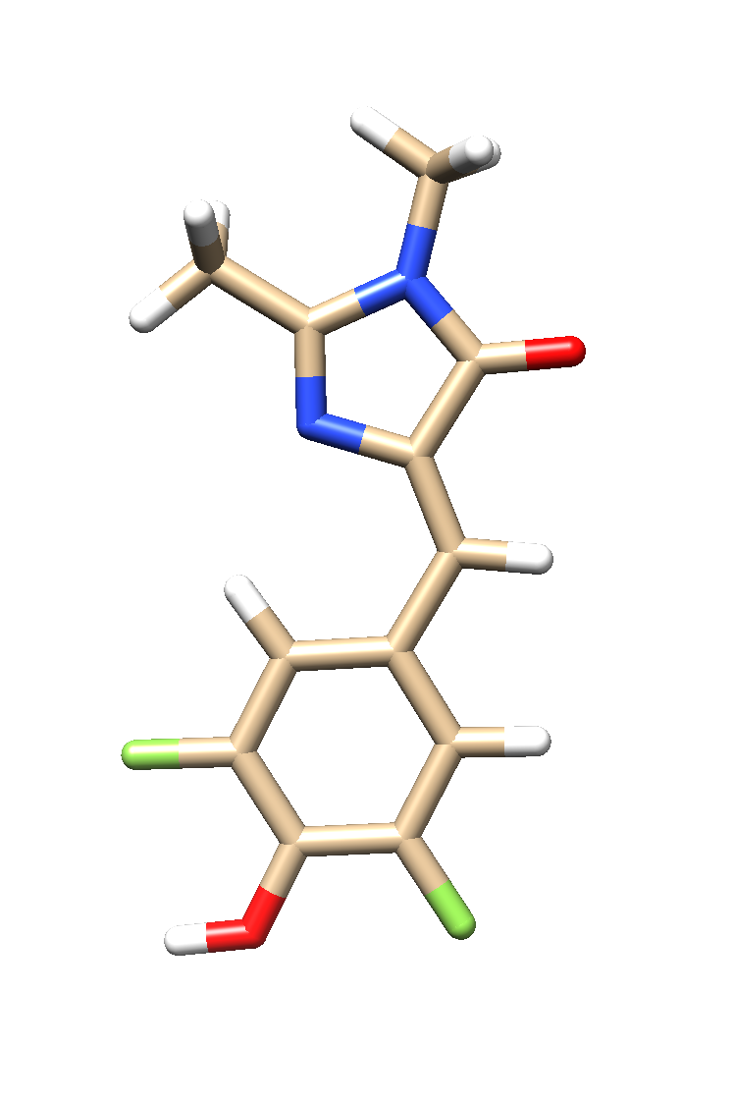
Matching 38E 5 Residue Hybrid Motifs with MPNN NTF2 Scaffold Library
Enumerate 3 residue polar motifs as previously described
To each, add 2 of the top 25 most populated nonpolar contacts and ensure no steric clashes
→500 5-residue hybrid motifs
matched with 419 NTF2 scaffolds
→18 matches
100 designs each with FastDesign
38E – DFHBI – fluoresces when constrained to this planar Z conformation

Slide 51
Rosetta Quality Metrics for 1,800 38E Designs
-
Ligand Hydrophobic SASA and CMS even better than for A8S (maybe cus of 2 nonpolar motif contacts?) Also bimodal…

Slide 52
Rosetta Quality Metrics for 1,800 38E Designs
-
Too many interface BUNS, Nitrogen hbond not recognized?

Slide 53
Selecting Designs for MPNN
38E – DFHBI
Enumerate 3 residue polar motifs as previously described
To each, add 2 of the top 25 most populated nonpolar contacts and ensure no steric clashes
→500 5-residue hybrid motifs
matched with 419 NTF2 scaffolds
→18 matches
100 designs each with FastDesign
54 Designs selected for MPNN with:
Interface BUNS <= 1
Ligand Hydrophobic SASA <= 10
Contact Molecular Surface >= 160
Temp = 0.1; 500 sequences each design
Design off for all 4 motif residues, as well as any residue with a res-ligand 2-body energy<0.0
Top 10 sequences for each of 54 inputs sent to AF

Slide 54
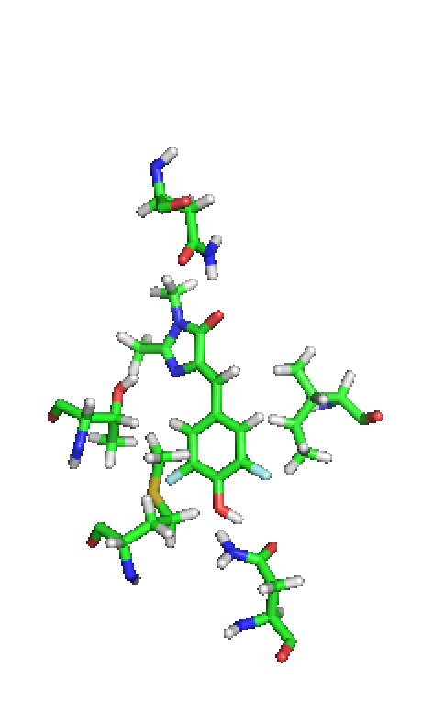
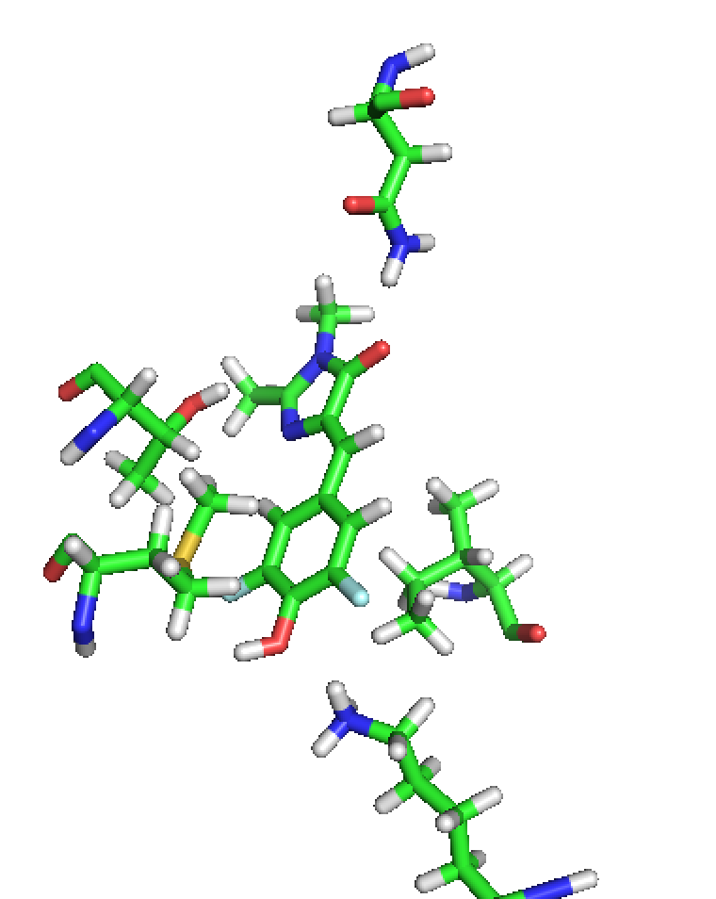
Selected Design Examples – matched motifs

Slide 55
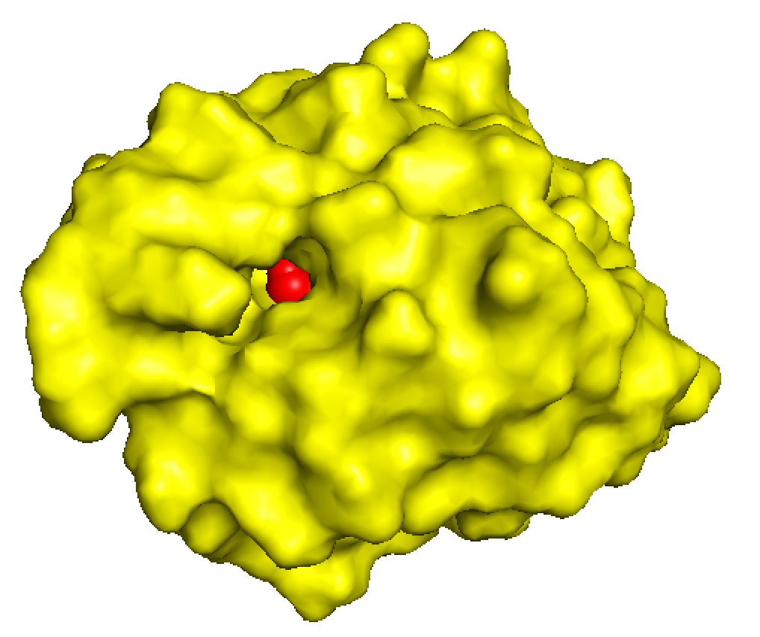
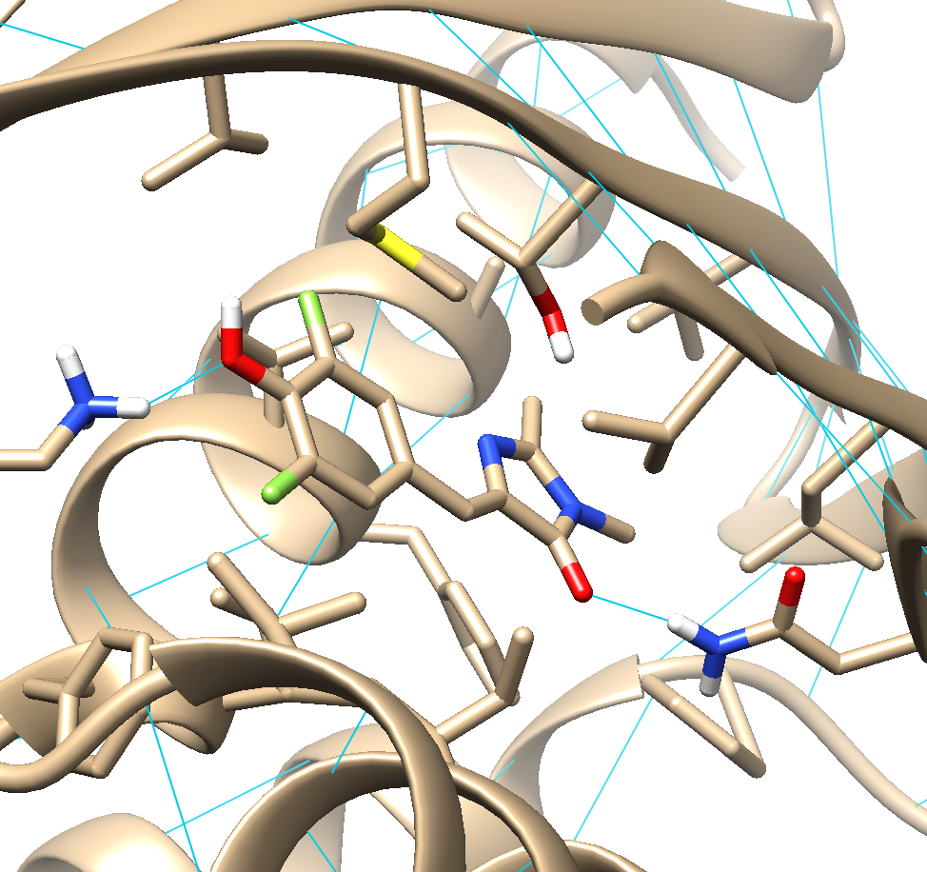
Selected Design Examples

Slide 56
AF Confidence for Filtered Rosetta Designs
8 designs with average plddt >= 85,
Ca RMSD <= 1.0 Å
LOOOOOOOOK AT THEMMMMMM

Slide 57
Rosetta Metrics for High Confidence Designs

Slide 58
Rosetta Metrics for High Confidence Designs

Slide 59
Compare with Values for Naturally Occurring Binders

Slide 60
Moving Forward
Get ligand back into MPNN designs
-not sweating it too much though, I already get FD designs with high AF confidence…

Slide 61
Moving Forward
Get ligand back into MPNN designs
-or don’t worry about it right now, I already get FD designs with high AF confidence…
Same design strategy but more computer power
-GOAL = designs that have same metrics as achieved here (low ddg, lig hphobe SASA, RMSD Rosetta;AF; high AF confidence, CMS) but also have higher Boltzman probabilities, which I think is really just a matter of making more matches+designs

Slide 62
Moving Forward
Paranoia about polar atoms in ligand/binding sites
-I use statistics to select contacts for individual ligand polar groups, but can I be more intelligent about how I assemble them into motifs?

Slide 63
Moving Forward
Paranoia about polar atoms in ligand/binding sites
-I use statistics to select contacts for individual ligand polar groups, but can I be more intelligent about how I assemble them into motifs?
-currently: Only Hbonds <2.4 Å
No more than 1 positive/negative residue.
Must have at least two different residue types
A single residue cannot be present in more than half of motifs output

Slide 64
Moving Forward
Paranoia about polar atoms in ligand/binding sites
-I use statistics to select contacts for individual ligand polar groups, but can I be more intelligent about how I assemble them into motifs?
-currently: Only Hbonds <2.4 Å
No more than 1 positive/negative residue.
Must have at least two different residue types
A single residue cannot be present in more than half of motifs output
-maybe add: No more than 1 ASN (SER/THR are useful because they don’t introduce extraneous polar atoms, really I want more of these)
Go back to explicitly modeling/matching hbonding rotamers and favor things like sc-sc hbonds within binding sites

Slide 65
Moving Forward
-What ARE the higher order features that make hbond networks in binding sites happy?
It’s murky, how are they compensated in apo state, how do they interact with water and how it affects energetics? PROBABLY BETTER TO MAKE BINDERS AND GET AT THESE QUESTIONS WITH STRUCTURAL STUDIES RATHER THAN TRYING TO FIGURE IT ALL OUT
-DFHBI useful because its hella easy to screen for binding activity, but additional entropy cost to fix that rotatable bond compared with A8S
-NTF2 backbones disadvantageous in that they don’t crystallize, I will get MPNN designed Rossman folds from the homies and try to get high quality designs from these as well
-Would be interesting to get designs with comparable quality metrics but unique designed hbond networks, compare structures, binding affinities, kinetics, etc.

Slide 66
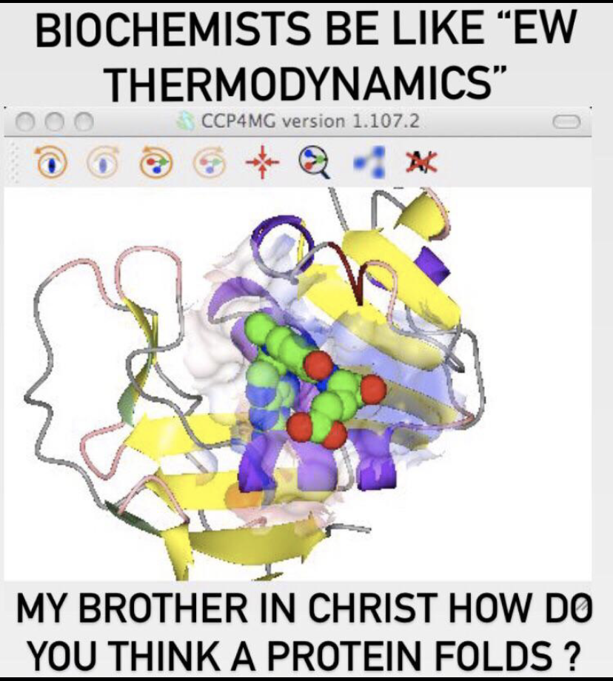
Thank you for your attention :)
Ssuggestions:
Make designs for digoxigenin

Slide 67
Subgroup 19 August 2022

Slide 68
Updates to Protocol
BSFF search for fragment containing molecules in PDB is now exhaustive/consistent
Only hydrogen bonds with distance <= 2.4 angstroms allowed in motifs (discarding highly populated clusters around 3.4 angstroms representing water-mediated hbonds)
Incorporating AF/ProteinMPNN into design workflow
→scaffold library now = 419 MPNN redesigned LUCS NTF2 structures with AF2 plddt >=80.0
→match design protocol = FD→MPNN (no design on binding site residues)→AF2→FastRelax w/ match csts→score

Slide 69
125 NTF2 structures in current library redesigned with MPNN: Round 2
FastRelax 125 highest plddt structures for each bb and submit for another round of design with MPNN
Temp=0.15; 1000 seqs per backbone
10 best scoring sequences for each backbone submitted to AF
Distribution of avg plddts for 125 original structures and 1250 selected MPNN designs
along with 125 highest plddt structures for each backbone:
Second round of MPNN increases mean plddt from ~73 to ~79 (~63 for originals)
After round 2, the mean plddt for the best design for each backbone increases from ~88 to ~91

Slide 70
419 Designs Selected for Matching
= up to 5 for each of 125 backbones, plddt>80.0
Comparison of Rosetta Metrics for 125 original and 419 selected ‘best’ Designs:
Fa atr lower
Fa rep higher
Statistical things lower (p_aa_pp, fa_dun)
Fa sol higher, lk ball lower

Slide 71
419 Designs Selected for Matching
= up to 5 for each of 125 backbones, plddt>80.0
Comparison of Rosetta Metrics for 125 original and 419 Designs:
Buried Nonpolar Surface Area
Cavity volume

Slide 72
Matching A8S 4-Residue Hybrid Motifs with MPNN NTF2 Scaffold Library
A8S
Enumerate 3 residue polar motifs as previously described
To each, add 1 of the top 25 most populated nonpolar contacts
→404 4-residue hybrid motifs
matched with 419 filtered LUCS scaffolds
→11,975 matches
2,218 matches randomly selected for FastDesign

Slide 73
AF Confidence for Filtered Rosetta Designs
3 designs with average plddt >= 85,
Ca RMSD <= 1.0 Å

Slide 74
Rosetta Metrics for High AF Confidence Rosetta Designs
19 heavy atoms - -1.096*19 = -20.824

Slide 75
Compare with Values for Naturally Occurring Binders
-
Boltz probabilities too low

Slide 76
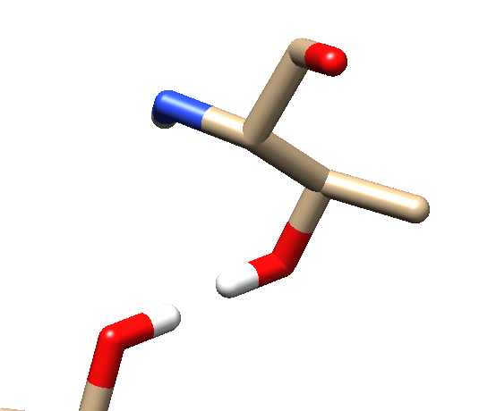
Weirdly orienting hydroxyl groups directly towards each other
The cause of this turned out to be upweighting hydrogen bond terms during design
Other hbond issues
Arginine:carboxylate interaction should be fixed to bidentate interaction only
Too many ‘problematic’ residues (ASN/GLN/ARG/LYS)

Slide 77
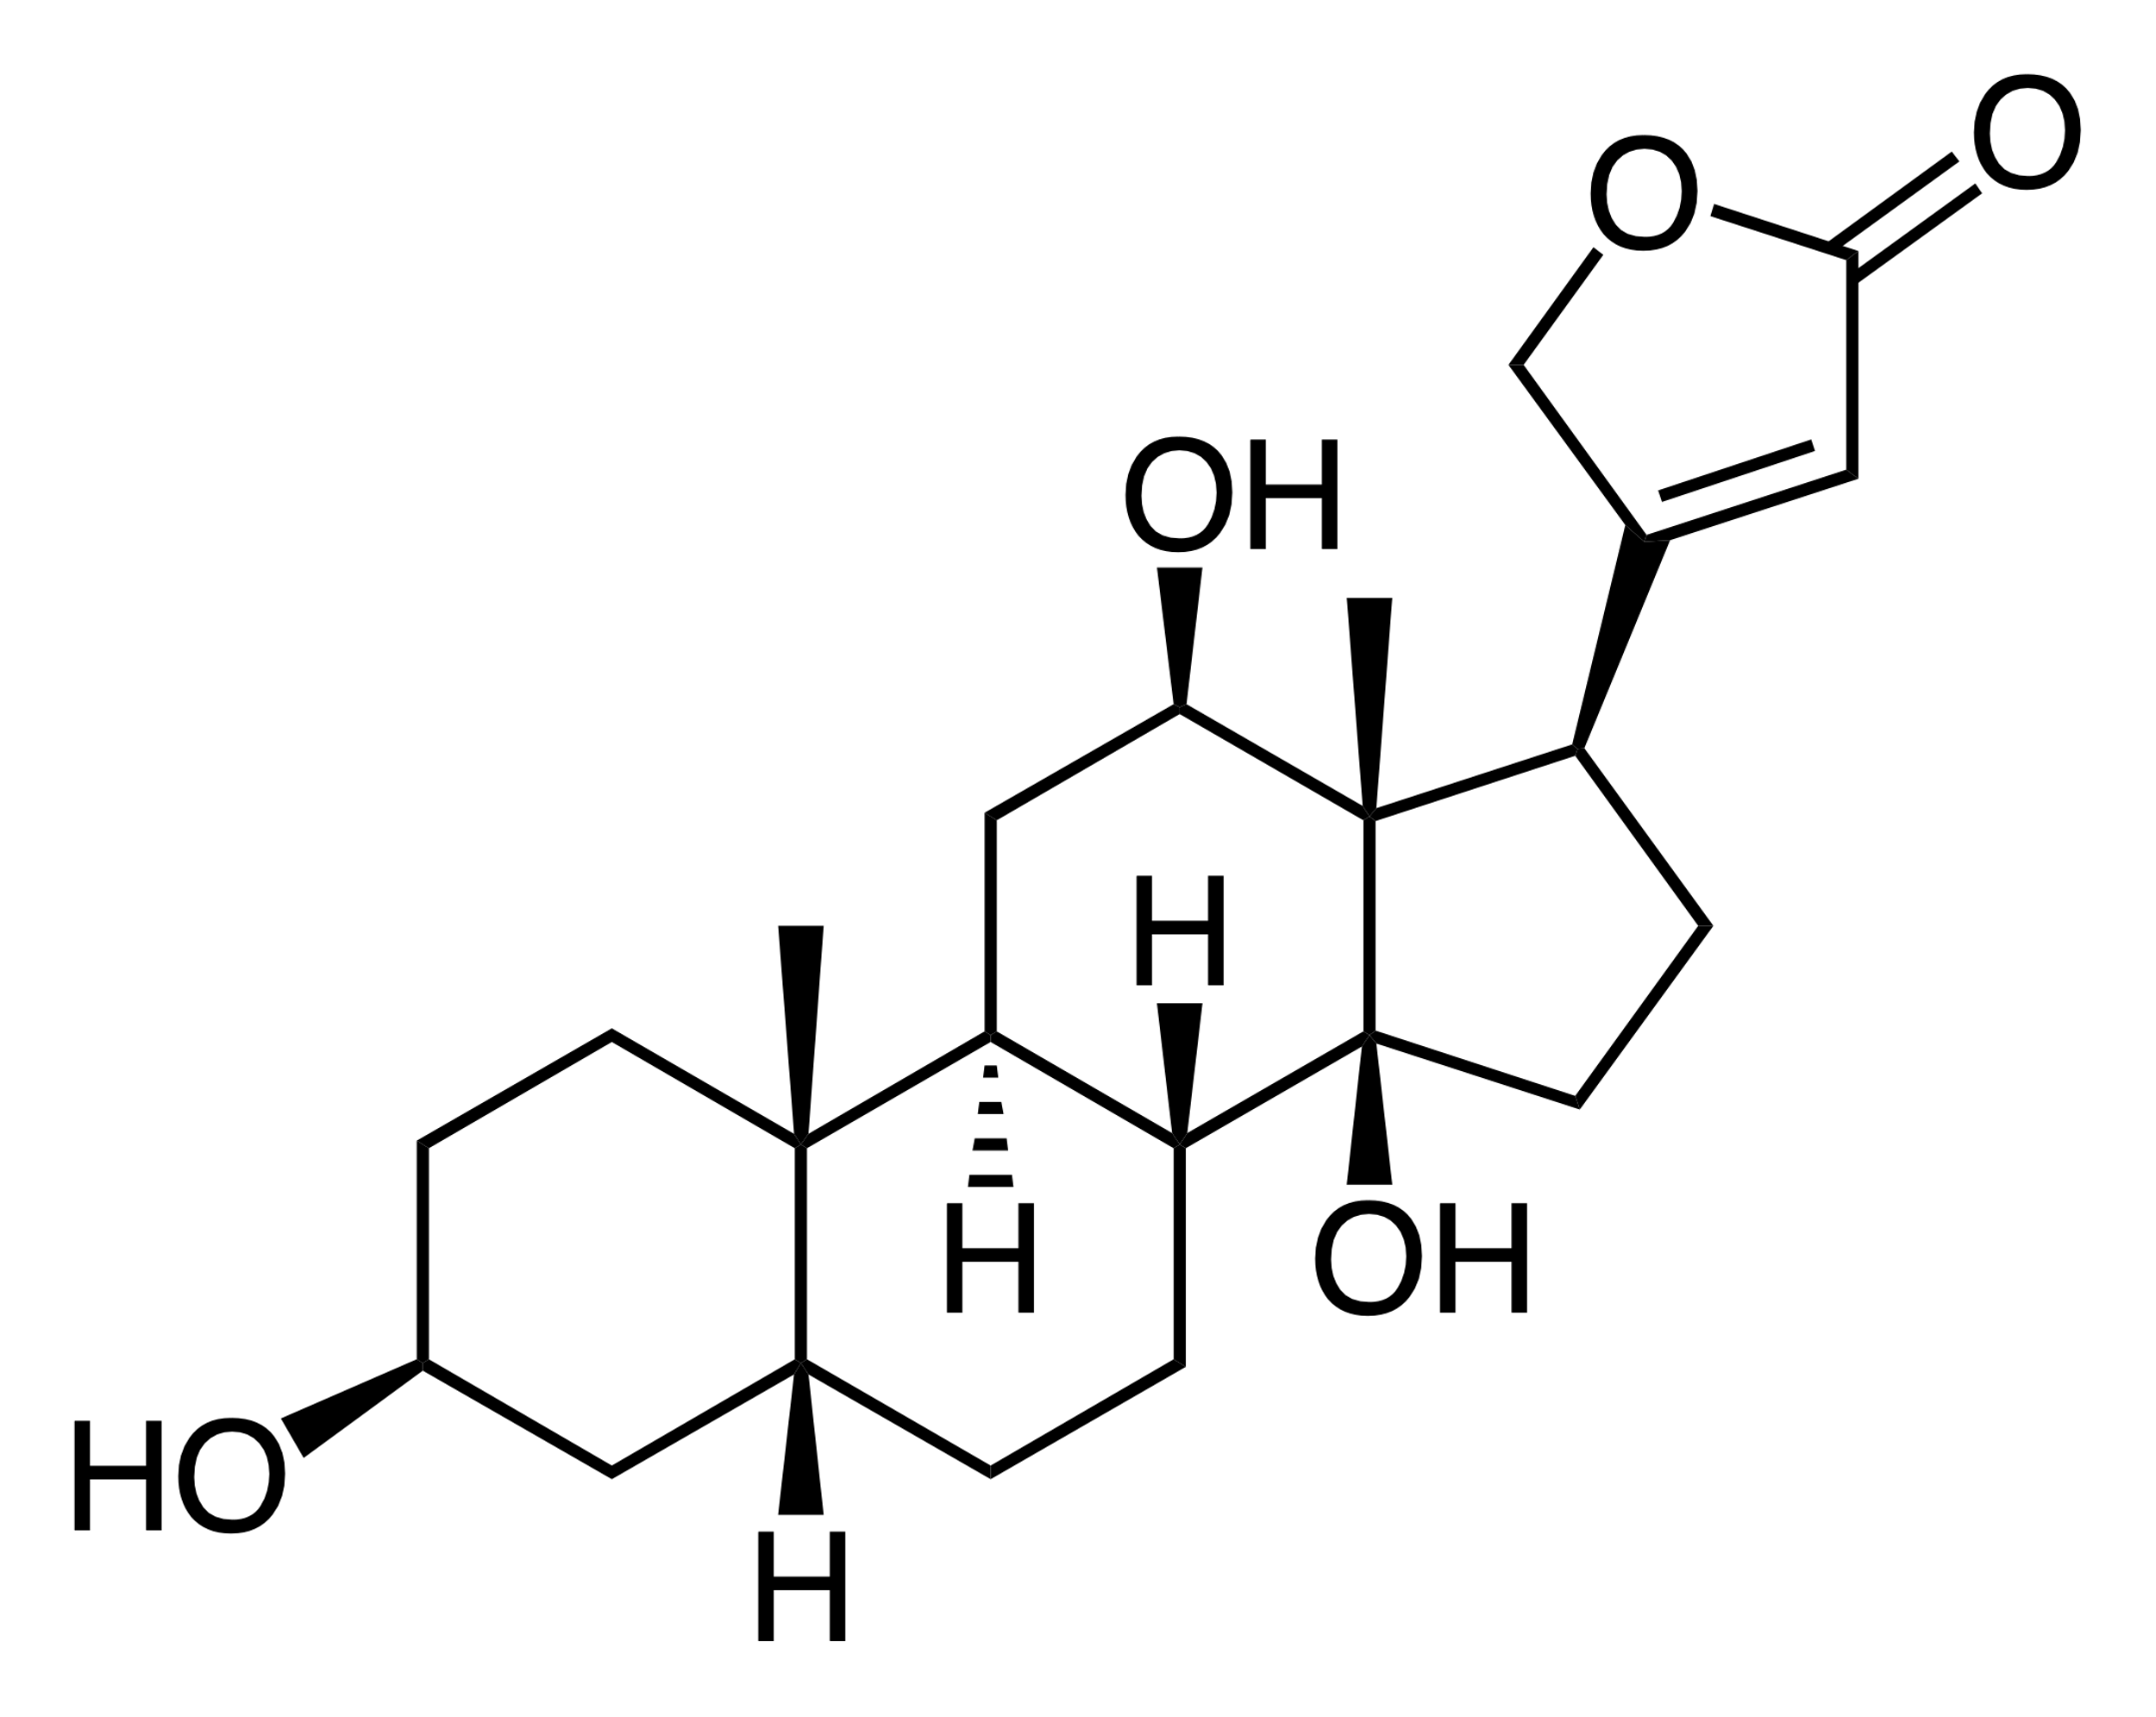
Design of Binders for Digoxigenin
419 MPNN designed NTF2 structures used for scaffold library
Idealized Hbond motifs used:
-4 residues, 1 for each oxygen (1 for whole lactone group)
-only allow 1 ‘problematic’ residue in motif, others must be SER/THR/TYR/HIS (I should probably chill with His though)
-Parameters:
distance 1.8 – 2.1 Å
psi 120 +/- 10˚
phi 180 +/- 15˚
chi 180 +/- 20 ˚

Slide 78
Design of Binders for Digoxigenin
4331 Matches from 100 nonredundant motifs
Produce 10 designs for each match with:
-FastDesign w/ match csts
-Ligand ScoreFunction
-Ligand interaxns upweighted x1.5
-FastRelax design w/o match csts
11 Designs with:
Buns2interface <= 0.0
Lighphobesasa <= 20.0
Hbtolig >= 4.0
Contact_molsurf >= 180
Boltz <= -0.3
Tinberg Criteria
Shape Complementarity > 0.5
At least 1 hbond residue w/ boltz < -0.1
Mean fragment RMSD < 0.8 Å
Somewhat awkwardly, these 11 filtered designs look better by eye than previous filtered designs, even though they were obtained without the use of BSFF

Slide 79
Design of Binders for Digoxigenin: Problems
Ddg values too high – should be ~ -30.0
→ Include BSFF-derived nonpolar contacts in motifs

Slide 80
Design of Binders for Digoxigenin: Problems
Alphafold RMSD high:
-no designs with plddt>85 and RMSD<1.0 Å
(3 designs with plddt>85, RMSD<1.5 Å)
→Use ProteinMPNN to generate a sequence profile for designable positions, sequence preferences will be used to inform design
-Allow design in MPNN only at positions which will be designable in Rosetta
-take sequence profiles of favorable sequences (score below some cutoff) at each designable position
-for designable positions in resfile, only allow residues which are seen in MPNN designs with a frequency greater than some cutoff
Would love to weight each residue type by observed frequency in MPNN designs but I’m not sure if that’s possible
How else could I potentially make this useful?

Slide 81
Design of Binders for Digoxigenin: Problems
Additional things to test:
-instead of using same ‘ideal’ params for every hbond type, I can be more specific to individual residue atom type:ligand atom type pairs
-I’d still like to promote hbond networks during design even though upweighting hbond terms messes up geometries
3BOP/HBNET
-CoupledMoves + GenericPotential ScoreFunction
###################################FEEDBACK/OTHER####################################
PSSM DESIGN
Compare mpnn seq profile w/ natural ntf2
Example of same scaff different matches to show diff binding modes
ROTATION PROJECT IDEAS:
designing binders
moad deeper analysis, hbond networks/other higher order properties
same w/ bsff, higher order properties
IDEALIZING MOAD SET -> DO IT UNTIL VERY LOW RMSD

Slide 82
deep manifold something something gligorejevic
Sampling problem
-->learning and sampling from functiomal ptn manifold using denoising autoencoders
language model
Sam pellock design of small mol binding ptns in hallucinated ntf2s
warfarin, cortisol, recuronium
lig rot lib, rifgen, rifdock, fd w/ pssm
1,2,40 micromolar b4 site sat mut to improve to nm range
evidently scaffold idealization was crucial to getting it to work
high throughput yeast display to test, sub 1% success rate (tested thousands)
Got a crystal for a cortisol binder (not in pdb yet)
Hi througput hdxms to measure ptn fluctuations rocklin
dom idea use this method to screen ptn switches
Praetorius de novo design of dynamic ptns
Possu Huang epitope specific antibody des via deep learning based strc modeling

Slide 83
Subgroup 1 September 2022

Slide 84
Another Round of Scaffold Design with MPNN/AF2
Input – 419 scaffolds from last round of MPNN design with average AF2 confidence >=80.0 across 5 models
→1000 MPNN designs each, temp=0.15
AF2 prediction for top 10 scoring designs on each input
New Scaffold Library = 515 scaffolds with average AF2 confidence>=90.0 and CA RMSD<=1.0 Å from input
-178 unique inputs from last round
-65 original LUCS scaffolds (out of 125)
→How different are the scaffolds originating from the same original LUCS structure? How different are the scaffolds originating from different LUCS structures?

Slide 85
DIG Binder Design
Same n res, only 86 variable,
Need contiguous terminal set
Of unchanging res
Motifs = 1 idealized hbond for each polar group (4 total) + 1 high frequency nonpolar interaction from BSFF
→only 7 matches
Without nonpolar contact (4 polar only) → 1077 matches (4331 previously)
-make many designs each with CoupledMoves, GenericPotential, PSSM with MPNN derived sequence profile, 3BOP/HBNet scoreterm, special rotamer bonus for high- frequency contacts?
Rotamer enumeration after pol matching, define best couple np,
Then gen mpnn prof
Running back mpnn on all ntf2 – link with steph for yeast display
-more than 10 mpnn submitted, best plddt/rmsd
Other steroids with different arrangement polar groups

Slide 86
Get match
Identify well buried matches
Mutate first shell (minus motif) to alanine/glycine and enumerate every rotamer of every residue to identify top tier packing interactions with ligand
favor aromatics for pi stacking?
Check combinations of good packing interactions and find low energy first shells
Generate sequence profile with mpnn across designable
Rotamer enumeration after pol matching, define best couple np,
Then gen mpnn prof
Running back mpnn on all ntf2 – link with steph for yeast display
-more than 10 mpnn submitted, best plddt/rmsd
Other steroids with different arrangement polar groups
Same n res, only 86 variable,
Need contiguous terminal set
Of unchanging res

Slide 87
Subgroup 7 October 2022

Slide 88
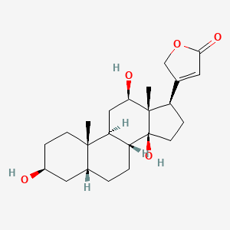
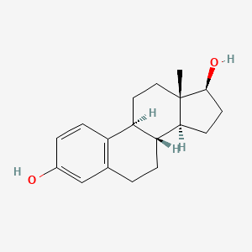
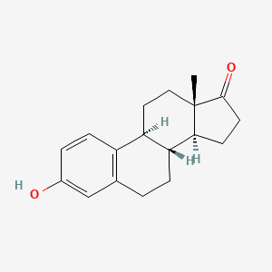
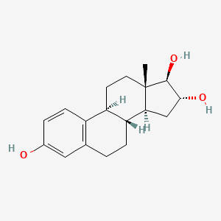
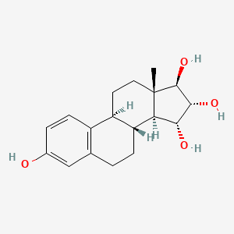
Steroid Targets with Different Polar Group Arrangements
Digoxigenin
Estradiol
Estrone
Estriol
Estetrol
Estrogens have same carbon skeleton with different number/arrangement of polar atoms, are cheap and reasonably soluble
(estradiol ~0.7 mM in 1% DMSO)

Slide 89
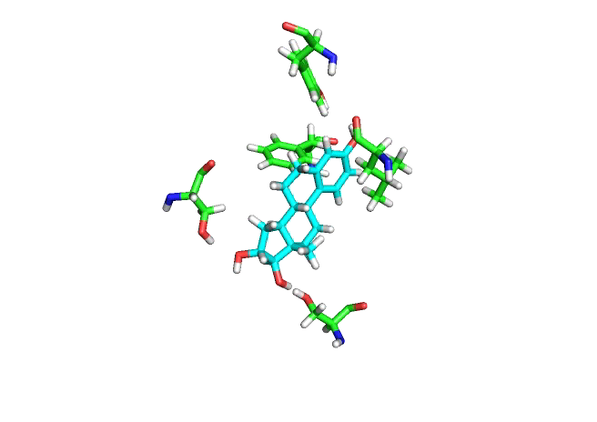
Estriol (ESL) Binder Design
215 5-residue motifs (3 Hbonds, 2 packing interaxns) screened against 515 NTF2 scaffolds → 208 matches

Slide 90
Estriol (ESL) Binder Design
215 5-residue motifs (3 Hbonds, 2 packing interaxns) screened against 515 NTF2 scaffolds → 208 matches
200 designs each match:
-enzyme design application
-generic potential scorefunction
-protein-ligand interaxns upweighted x2.5
155 designs satisfying filters:
-Interface BUNS = 0
-Number Hbonds to Ligand >= 3
-Rotamer Boltzmann > 0.33
-DDG < -22.0
-Contact Molecular Surface > 160
-Shape Complementarity >= 0.66
-Ligand Hydrophobic SASA <= 20 Å²
Filtered designs originate from 21 unique matches which include 12 unique motifs and 18 unique scaffolds

Slide 91
Binding Metrics of Designed ESL Binders
165
-30
-0.28
0.76
4
1.1

Slide 92
Rosetta Stability metrics for Filtered Designs

Slide 93
AF2 Confidence for Filtered Designs
15 Designs with plddt >= 88 and CaRMSD <= 1.2 Å
-originate from 2 unique matches

Slide 94
Design for Stability with MPNN-derived Sequence Profile
For each of 155 designs filtered for good binding metrics:
-Identify residues that either hydrogen bond with ligand or have <= -2.0 REU pairwise interaction with ligand (~ 5- 10 residues per structure), allow MPNN to design on all other residues
-Generate 500 sequences each with MPNN, temperature=0.2
-Identify sequences with score <= 1.0 (~350-450)
-Use Rosetta FastDesign to generate 100 designs on each of 155, allowing at each position all residues seen in filtered MPNN sequence profile as well as original residue (~1-9 residues each position, median ~4)
-3BOP included in FD scorefunction
Designs filtered on all of original binding metrics to ensure they’re retained, as well as stability metrics:
-backbone buried unsats <= 2
-sidechain buried unsats = 0
-oversaturated polar atoms = 0
-packstat >- 0.65
-exposed hydrohphobic surface area <= 800 Å²
→ 192 designs pass all filters, submitted for AF2 structure prediction

Slide 95
Rosetta Stability Metrics of MPNN Informed Designs
Before mpnn
After mpnn

Slide 96
Rosetta Stability Metrics of MPNN Informed Designs
Before mpnn
After mpnn

Slide 97
Rosetta Stability Metrics of MPNN Informed Designs
Before mpnn
After mpnn

Slide 98
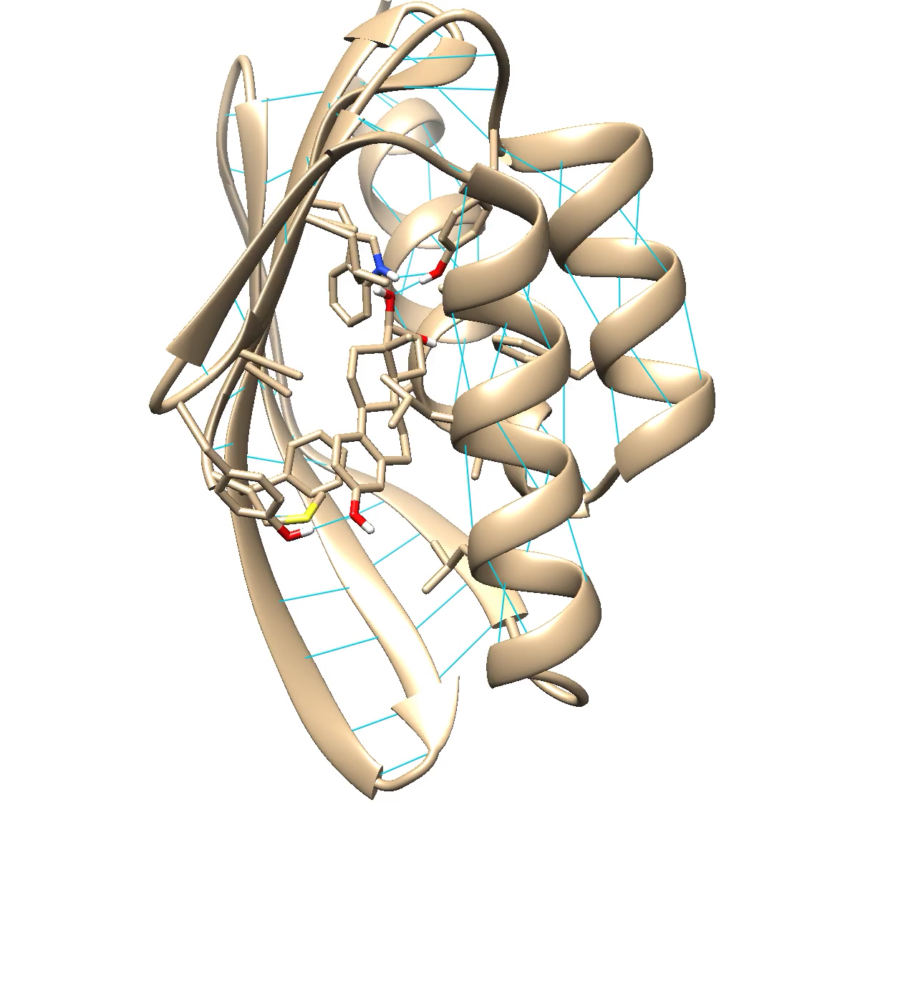
AF2 Results for Filtered MPNN-Informed Designs
17 designs with plddt >= 88 and CaRMSD <= 1.2 Å (compared with 15 before mpnn)
-all originate from 1 match

Slide 99
Next Moves
I get reasonably large set of designs satisfying stringent Rosetta stability/binding metric filters, but comparatively few with high AF2 confidence/low CaRMSD
-maybe im being too stringent (NTF2s have a lotta bb BUNS, binding metrics way better than mean values for nanomolar binders in PDB, maybe can relax AF2 confidence threshold and focus more on CaRMSD…)
Matched 3 hydrogen bond + 1 packing interaxn motifs, > 30k matches, will perhaps produce larger + more diverse set of filtered structures (can also make like 1k designs each match instead of 200, though I’d expect only marginal improvement from this alone)
Diffdock
Ptn lig strc prediction https://arxiv.org/pdf/2209.15171.pdf
How to do yeast display? ID a set of strc in current designs to express, ITS TIME
Degrado sm binder meetings https://ucsf.zoom.us/j/95065542919?pwd=TUtaNkhwbXBBWHdYbHhSYU5LN0lhZz09
every Tuesday 4-5
MAYBE GO BACK TO XJ FILT NTF2, GET ALL OF PROP LENGTH, MPNN REDESIGN, THEN MATCH (THAT SMALL ENUF 4 YEAST DISPLAY)
Ask ben more about 350 nucleotide yeast display prospects

